Slide 1
Ivan Genchev
Open Source DevOps Engineer at KPMG ITS

Slide 2
ElasticSearch
Not an easy backup

Slide 3
Contents
Introduction
How it started
Solutions
  Plugins
  Supported Storage
  Unsupported Storage
Lessons Learned
Q & A

Slide 4
Introduction
What I do
  Deploy applications
  Troubleshoot infrastructure
What I know
  Linux SysAdmin for 10+ years
  Kubernetes for 1 year
What I want to tell you

Slide 5
How it started

Slide 6
How it started
K8s cluster
ElasticSearch + FluentD + Kibana logging
  https://github.com/pires/kubernetes-elasticsearch-cluster
Operations Manual
External Documentation

Slide 7
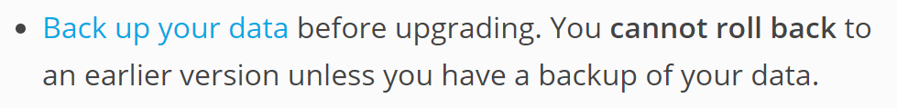
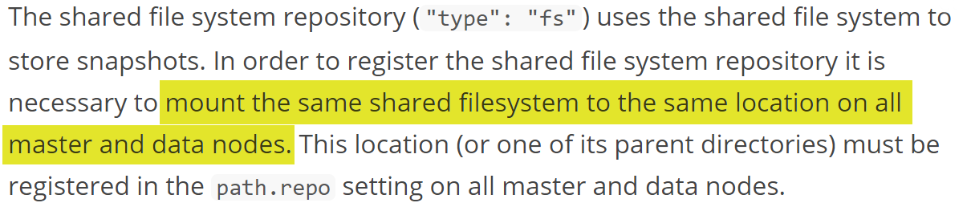
How it started

Slide 8

How it started

Slide 9
Solution 1
ElasticSearch Plugin

Slide 10
ElasticSearch Plugin
No Kubernetes required!
(“type”: “fs”) plugin is default, not mandatory
Commercial Cloud solutions
  S3
  Azure
  GCS
Hadoop HDFS

Slide 11
Custom container with required plugin installed
Configure backup plugin
Profit!

Slide 12
Solution 2
Supported Storage

Slide 13

Supported storage
PV outside STS
ReadWriteMany
Volume Plugin | ReadWriteMany
AzureFile | ✓
CephFS | ✓
Glusterfs | ✓
Quobyte | ✓
NFS | ✓
PortworxVolume | ✓

Slide 14
Solution 3
Unsupported Storage

Slide 15
Unsupported Storage
Wrap the unsupported storage in a supported one
  Unsupported PV
  NFS server
  ReadWriteMany PV on top of NFS

Slide 16
Lessons Learned

Slide 17
Lessons Learned
Know your payload
  RTFM
  Contact the Devs
  Sandbox and trace
GitHub/Blog YAMLs are a starting point
Ounce of prevention >= Pound of cure

Slide 18
Examples
github.com/kmpg-igenchev/es-backup

Slide 19
Q & A

Slide 20
Thank you

